Slide 1

Daria Krasnova
Vadim Piven
Njoh Arnaud
Pavel Popov
Project Manager, Tester
Backend
Android Application
Analyst

Slide 2
General idea
Android application interacting with backend via REST API
The idea is to collect user content with location bindings
The main screen contains the map with user posts
Posts could contain images, text and hashtags
Posts are hidden when new ones are created by the user
Posts are searchable by authors’ username or hashtags
Friends, messaging and other social media functions should be added
Collected data should be further analyzed for building emotional spectrogram

Slide 3
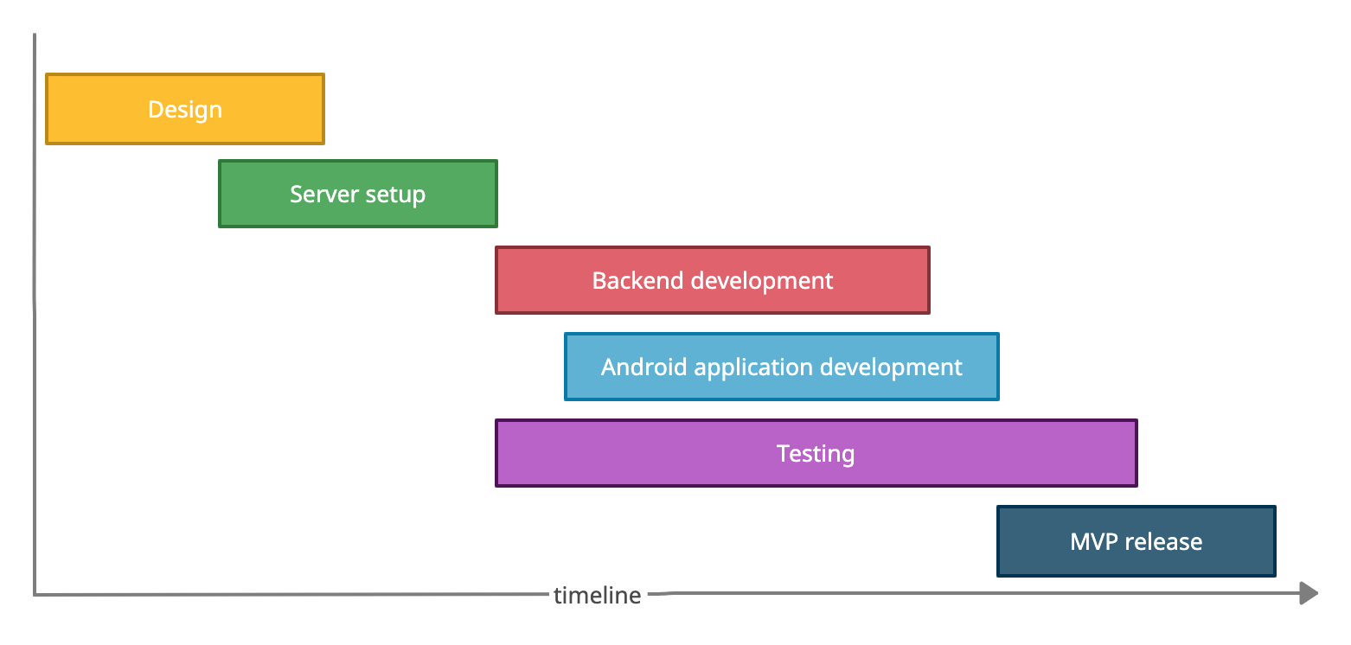
Development timeline

Slide 4


Design & Management
Trello is used for task management
Discord is used for communications

Slide 5
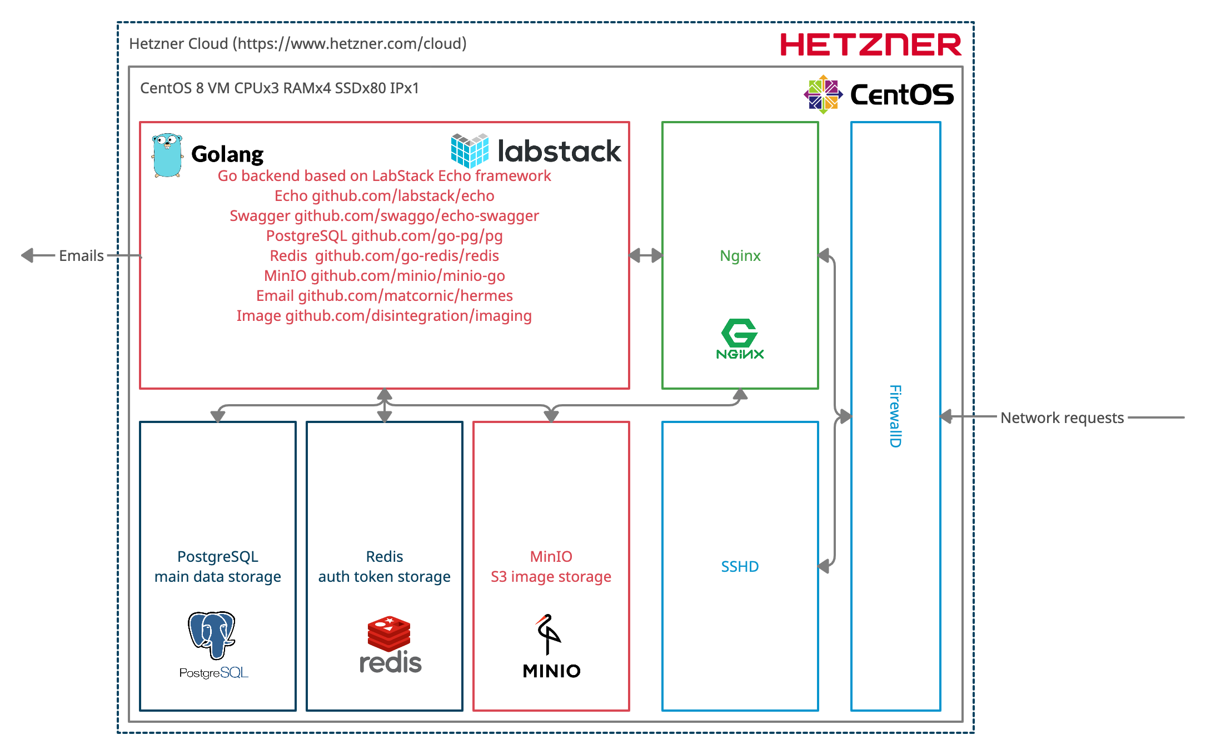
Backend

Slide 6
Android application

Slide 7
Android application

Slide 8

Testing

Slide 9
Testing

Slide 10
Let us proceed for the demo

